Slide 1
ISM 6225 Distributed Information Systems
Lecture – Computational problem solving – Algorithms, Data structures

Slide 2
Agenda
Algorithms
Searching
Sorting
Recursion
Big O notation
Data structures
Lists
Trees
Dictionaries

Slide 3
Code walk-through
Search
https://github.com/ISM6225/Binary_Search.git
Fork to open the solution in your IDE
Sort
https://github.com/ISM6225/Sort.git
Fork to open the solution in your IDE
Data structures
https://github.com/ISM6225/L2_Algorithms_DataStructures
Fork to open the solution in your IDE

Slide 4
Algorithms
Definition
Computational procedure to solve a problem
Using allowed operations
Algorithms are precise, unambiguous, mechanical and correct (Dasgupta et al)
Named after Muḥammad ibn Mūsā al-Khwārizmī (780 - 850)
Persian Scholar, who lived in Baghdad
Wrote The Compendious Book on Calculation by Completion and Balancing (813-833)
Provided systematic solutions for linear and quadratic equations

Slide 5
Algorithm Example
Let’s follow the steps to prepare a hot dog for lunch:
Get the cooking pot
Get some water to boil
Do we have water to boil?
If yes, add the water to the pot.
If no, do we have a problem with our water supply?
If yes, then contact the water company for service.
If no, there is no water - then terminate.
Get a hot dog to cook
Do we have a hot dog?
If yes, add the hot dog to the water
If no, do we want to go to the store and buy hot dogs?
If yes, then go to the store.
If no, the terminate
Turn on the stove to boil the water …

Slide 6
Algorithms - complexity
Different algorithms can be used to solve the same problem
Usually differ in efficiency or “smartness”
Typically, there is a preferred algorithm to accomplish a common task
E.g. Java sort uses TimSort
Also, see https://stackoverflow.com/a/12228697/1385857
In the context of writing computer programs, algorithms are typically compared for
Time complexity
How long does the algorithm take to do its job, as the size of the input increases
Space complexity
How much data storage does the algorithm need to do its job, as the input increases
Not seeing much reference to this these days
less important, as storage gets cheaper?
Complexity is especially critical for big data contexts

Slide 7
Algorithms - evaluation
Given an algorithm, you should always ask 3 questions about it (Dasgupta et al)
Is it correct?
How long does it take to do its job, as its input (n) gets larger?
Shortly, we will see the big O notation used to describe this
Can we do better?

Slide 8
Algorithms - motivation
Why should a BAIS student care about algorithms?
Or, aren’t algorithms already available as part of APIs?
Our answer in ISM 6225
For canonical tasks (e.g. search, sort), yes, algorithms are available in APIs
But, most business problems are not simple canonical problems
As solution developers, you need to break business problems down into canonical parts, for which efficient algorithms exist
Hence, need an awareness of canonical algorithms
Defines the set of allowed operations to solve the business problem
Appropriate decomposition can make the difference between an economically feasible solution and an unviable solution
Especially for big-data applications

Slide 9
Algorithms – motivation (contd.)
Most famous contemporary technology businesses are algorithms-driven businesses
Google – algorithms to rank web page relevance for a given search term
Facebook, LinkedIn – algorithms to find friends-of-friends
Netflix, Amazon – find users with similar tastes
Awareness of algorithms can determine when to use approximate solutions, heuristic solutions etc
Awareness of algorithms can also determine how to deploy solutions
e.g. in public key cryptography, the keys are very asymmetric
One side does a lot more work than the other side
Servers can save the difficult work as their private key and make the public key simpler

Slide 10
Algorithms - introduction
In this course, we will introduce baseline algorithms for 2 common programming tasks
Search
Simple search, Binary search
Sort
Selection sort, Bubble sort
For simplicity, we will use primitives and the simplest collection data structure
Arrays
We will also introduce an essential technique - recursion

Slide 11
Algorithms - introduction
Strongly encouraged to use the assignment to begin thinking algorithmically
Recommended read
http://algorithmics.lsi.upc.edu/docs/Dasgupta-Papadimitriou-Vazirani.pdf
read like a story, skip difficult paragraphs
Even includes quantum algorithms (chapter 10)
Authoritative read
CLRS
Thomas H. Cormen, Charles E. Leiserson and Ronald L. Rivest, “Introduction to Algorithms”

Slide 12
Search algorithms
Algorithms to retrieve stored information
Linear search algorithm
Look at each value in the collection
Compare it to the value being searched
E.g. search for 2 in [5, 7, 14, 9, 3, 6, 2]
Is the algorithm correct?
Yes, will find the number if it exists in the collection
How long will it take?
If we have n numbers, we may have to do up to n comparisons
Can we do better?
Perhaps

Slide 13
Binary search
How do you search for a word in a dictionary?
Or a name in a phone-book?
Binary search algorithm
Pre-condition: input data is already sorted
Compare the number to the mid-point of the collection
If the number is less than the mid-point
Search in the left-half of the collection
Else
Search in the right half of the collection

Slide 14
Binary search – example
E.g. search for 2 in [5, 7, 14, 9, 3, 6, 2]
Sort the array: [2, 3, 5, 6, 7, 9, 14]
Compare 2 to 6
mid-point in collection
New collection is [2, 3, 5]
Compare 2 to 3
mid-point in collection
New collection is [2]
Compare 2 to 2

Slide 15
Binary search algorithm
Is the algorithm correct?
Yes, will find the number if it exists in the collection
How long will it take?
The search collection keeps reducing in half in each iteration
To search n numbers, we have to do x iterations such that 2^{x} = n
So, we may have to do up to log(n) iterations
Can we do better?
Fastest method known so far

Slide 16
Comparing algorithms
Simple search or binary search?
Which is better?
Time complexity of algorithms in the worst case is represented in the Big O notation
How does the time needed for the algorithm to complete its job increase as the input size grows and nears infinity?
Think of it as order-of
Simple search is a O(n) algorithm
Binary search is a O(log(n)) algorithm
Log(n) grows very slowly compared to n
So, binary search is superior to simple search

Slide 17
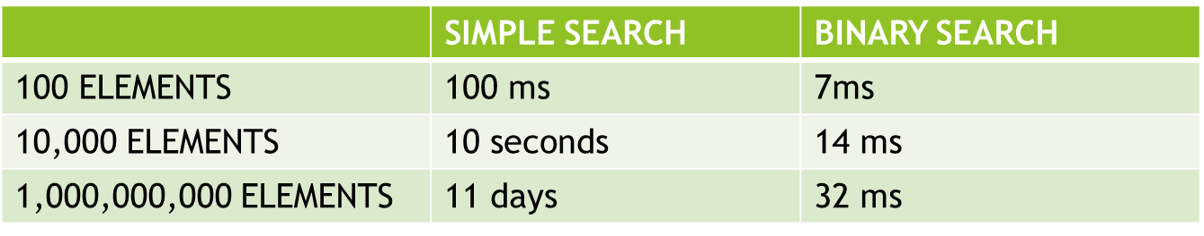
Big O Notation = Algorithm Efficiency
A special notation that tells you how fast an algorithm is
The run time to two algorithms can grow at different rates
Should I use Simple Search or Binary Search?
Let’s run both algorithms with 100 elements
Let’s assume that it takes 1 millisecond (ms) to check one element
So, the simple search takes 100 ms to run
The binary search (log₂ 100 is roughly 7) takes 7 ms to run
Notes:
At first glance, when we test 100 elements – Binary Search seems 15 times faster than Simple Search. But, as the number of elements increases, binary search takes a little more time to run. But simple search takes a LOT more time to run. So as the list of numbers gets bigger, binary search suddenly becomes a lot faster than simple search.
You need to know how the running time of an algorithm increases as the size of the data increases.

Slide 18
Sorting algorithms
General idea
Move elements of an array one at a time to their final position in order
Simple approach
Search through all elements in the collection, find the smallest element
Place it in the first position
The array is now sorted till position 1
Remaining n – 1 elements are unsorted
Treat this as the new collection
Repeat
More sophisticated approaches replicate binary search idea
Recursively sort half the array and merge the halves

Slide 19
Bubble Sort
Starting from the left most element of an array size N, compare the adjacent element to see if it is smaller (min)
If the element is smaller, then “bubble” (or swap) the larger element to the right
Complete a pass through the entire array, swapping each adjacent element if needed
Repeat the bubble sorting of the array N – 1 using an iterative loop by re-passing through the entire array until the sorting is complete
Worst Performance (Big O Notation): O(n^2)
Animated Example: https://www.youtube.com/watch?v=nmhjrI-aW5o&feature=youtu.be

Slide 20
Selection Sort
Scan all elements in array and identify the smallest (min)
Once min element is located, swap it with the first element
Repeat this selection sort process on the remaining N-1 elements using an iterative loop
Worst performance (Big O notation) is: O(n^2)
Same time complexity as Bubble sort, but slightly fewer comparisons
Animated example: https://www.youtube.com/watch?v=xWBP4lzkoyM&feature=youtu.be

Slide 21
Bubble sort vs selection sort
Both algorithms sort the data collection by successively identifying the element that belongs to position
Therefore, both algorithms have the same time complexity
However, note the additional swaps inside the nested loop in bubble sort
Probably creates additional work that is unnecessary for the final result

Slide 22
Recursion
Many important problems can be solved by divide-and-conquer
Divide the original problem into several smaller sub-problems
Each sub-problem similar to the original problem
If small enough, conquer the sub-problem directly
Else, solve each sub-problem in the same way as the main problem (recursion)
Combine the solutions to all sub-problem into final solution for problem

Slide 23
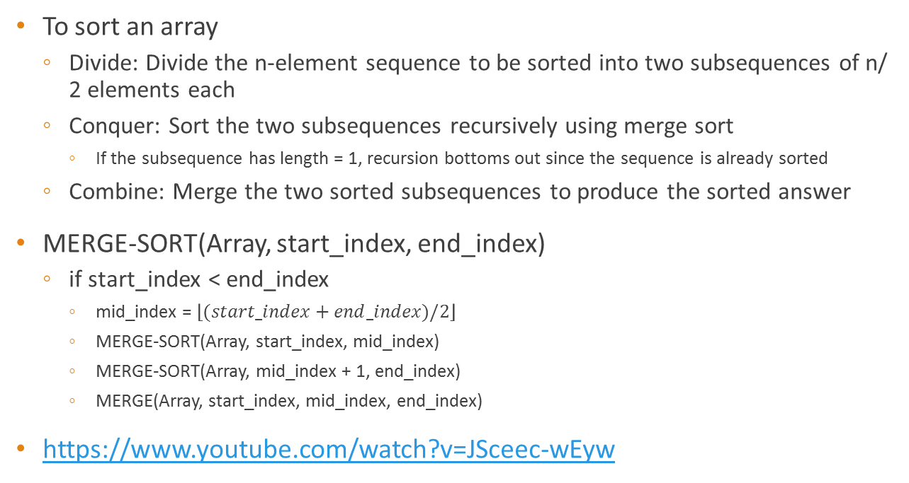
Recursion example – Merge sort
To sort an array
Divide: Divide the n-element sequence to be sorted into two subsequences of n/ 2 elements each
Conquer: Sort the two subsequences recursively using merge sort
If the subsequence has length = 1, recursion bottoms out since the sequence is already sorted
Combine: Merge the two sorted subsequences to produce the sorted answer
MERGE-SORT(Array, start_index, end_index)
if start_index < end_index
mid_index = $\left\lfloor (start_index+end_index)/2\right\rfloor$
MERGE-SORT(Array, start_index, mid_index)
MERGE-SORT(Array, mid_index + 1, end_index)
MERGE(Array, start_index, mid_index, end_index)
https://www.youtube.com/watch?v=JSceec-wEyw

Slide 24
Data structures
Computer programs commonly need to work with collections of objects
E.g. words on a page, records from a database, sessions on a server
Working with individual variables such as x and y is actually rare
Usually just counters, flags etc
These object collections are dynamic
Users add, update and delete objects from these collections. Also read
Collection size not known at time of compilation
It is therefore useful to have efficient ways to represent and manipulate object collections
Representations of object collections are called data structures

Slide 25
Data structure considerations
Capability typically comes at a cost
E.g. Arrays are easy to work with
But if chosen inappropriately, can waste a lot of memory
Therefore, when picking a data structure
Useful to know the operations that will need to be performed with the object collection
Four data structures discussed here
Arrays
Lists
Trees
Hash maps

Slide 26
Arrays
A collection of elements, where each element is identified by its position in the collection
Example
int[] ExampleArray = new int[5];
ExampleArray[0] = 0;
ExampleArray[1] = 1;
Console.WriteLine(ExampleArray[0]);
Console.WriteLine(ExampleArray[1]);
Console.WriteLine(ExampleArray[2]); // what to expect here?

Slide 27
Array initialization alternatives
string[] weekDays1 = new string[] { "Sat", "Sun"};
string[] weekDays2 = {"Sat", "Sun"};

Slide 28
Multi-dimensional arrays
int[,] Array2D = new int[4, 2] { { 1, 2 }, { 3, 4 }, { 5, 6 }, { 7, 8 } };
// What will this print?
Console.WriteLine(Array2D[3,1]);

Slide 29
Arrays – pros and cons
Pros
Easy to understand
All elements of the collection are typically stored contiguously in memory
Allow all set operations (e.g. CRUD)
Allow random access to any element of the array
Instant access if index is known O(1)
Instant insert if index is known O(1)
Cons
Cannot be resized after creation
Potentially, a lot of wasted space
Insert, search, delete operations can take O(n) or O(log(n)) time if index is not known

Slide 30
Linked lists
A data structure in which each element links to the next element in the data structure
Lists may be
Sorted
Doubly linked to facilitate traversal
Linked lists are used to implement almost all other data structures
E.g. trees, graphs, heaps, stacks
List head
7
23784
11
/

Slide 31
Linked lists – pros and cons
Pros
Very efficient at using storage
Vary in size as needed
Support all set operations
Cons
Technical on-ramp for understanding insert, delete operations
No random access
All operations require list traversal, can take O(n) time

Slide 32
Important historical note
Linked lists were created by Alan Newell, Herbert Simon and Cliff Shaw in 1955
Same team that defined the term “Artificial Intelligence” at exactly the same time
Linked Lists were created to develop AI programs
Thus, Linked Lists and Artificial Intelligence are “joined at the hip”

Slide 33
Linked Lists – useful links
https://en.wikipedia.org/wiki/Linked_list
https://docs.microsoft.com/en-us/dotnet/api/system.collections.generic.linkedlist-1?view=netframework-4.8

Slide 34
Trees
Linked data structure, in which each node contains data, and pointers to other similar nodes
We will consider binary search trees
Each node has
Key and data
Pointers to left and right nodes
Pointer to parent node
Binary search tree property
For each node of the tree
The key for the node on the left ≤ key of node
Key for the node on the right ≥ key of node
15
6
18
3
7
17
20
2
4
13
9

Slide 35
Searching a binary search tree
Recursive version
TREE-SEARCH (node, key)
if node == NIL or key == node.key
return node
if key < node.key
return TREE-SEARCH(node.left, key)
else return TREE-SEARCH(node.right, key)
Iterative version
ITERATIVE-TREE-SEARCH(node, key)
while x ≠ NIL and key key ≠ node.key
if key < node.key
node = node.left
else node = node.right
return x

Slide 36
Insertion in binary search tree
TREE-INSERT(Tree, node)
y = NIL
x = Tree.root
while x ≠ NIL // locate insertion point
y = x
if node.key < x.key
x = x.left
else x = x.right
node.parent = y
if y == NIL // Tree was empty
T.root = node
else // insert node
if node.key < y.key
y.left = node
else y.right = node

Slide 37
Trees - Challenges
Consider two situations with identical data
Applying insertion algorithm
Data arrives in sequence
1 → 2 → 3 → 4 → 5
Data arrives in sequence
3 → 2 → 4 → 1 → 5
Second tree is “balanced”
Search times will be O(log(n))
The first tree is just a list
Search times will be O(n)
Can we make search times more predictable
Regardless of data arrival sequence
1
Unbalanced tree
2
3
4
5
3
Balanced tree
2
4
1
5

Slide 38
Red-Black trees
Binary search tree with one additional bit per node
Color bit
0 = Red
1 = Black
Properties of red-black trees
Every node is either red or black.
The root is black.
Every leaf is null and is black.
If a node is red, then both its children are black.
For each node, all simple paths from the node to descendant leaves contain the same number of black nodes.

Slide 39
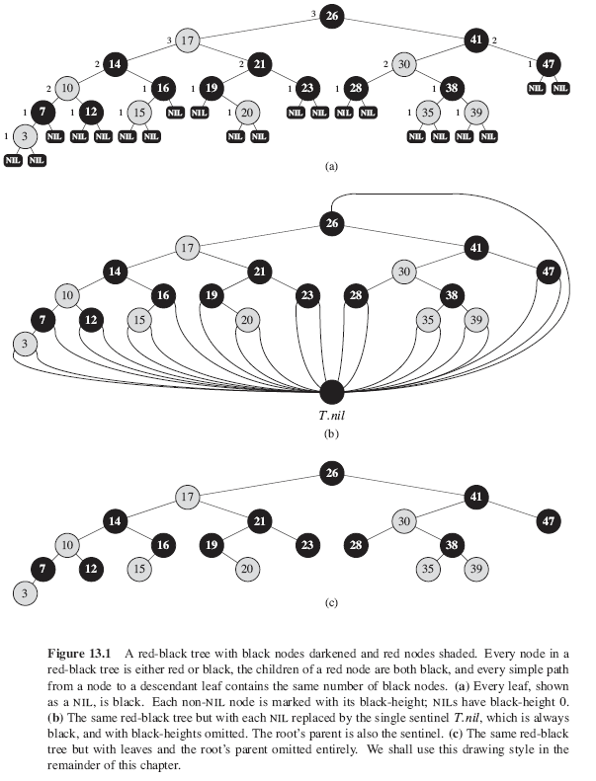

Slide 40
B-trees
Balanced search trees
Created by Bayer and McCreight in 1972 at Boeing
Used by most commercial database systems
Designed to work well on hard disks
Disk operations are very, very slow
So, minimizing I-O operations is helpful
Aim for each read operation to read a full page of data
Similar to red-black trees
Each node can have several child nodes (branching factor)
Reduces max tree depth
Size of node ≈ Page size
Retrieve one entire node from one disk read

Slide 41
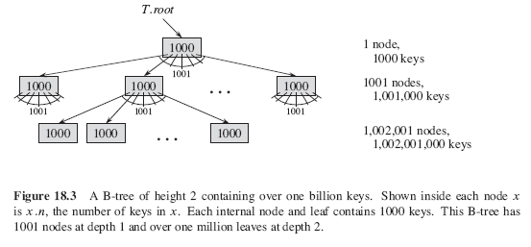
B-tree benefit example
Say we want to store up to 1 billion keys
Say, each node has up to 1,000 keys
Keep root node in memory
We can find any key in the tree with at most 2 disk lookups

Slide 42
Hash tables
Useful data structure for large, dynamic collections
Useful when the goal is quick storage and search of items
i.e. no need for sorting, or to keep record of next item, previous item etc
Combines the benefits of arrays and lists
Direct addressing of arrays
Dynamic allocation of lists
Therefore, can give O(1) search time with dynamic allocation of storage
As an example, consider session management at web servers
Given a session key, how can we identify which session this is
So we can respond with the content appropriate for the session
Or, given a form submission request, how can we confirm that the request is legitimate?

Slide 43
Hash table motivation
Web forms typically use tokens
Example from EdVisionApp below
<input name="__RequestVerificationToken" type="hidden" value="eFkbm-EI1hopFSOXdujnHhmFVPIo6L4x7K0DJrdUhgEJmegna2XAPDOem3v5YBKIgV_xuycDSAYa03PaFOJ_t6LuOln9L715pm-LHvXkgbIwjT5UiX0VBhMnfdC7PgCsYcMwyuOA5FZkwtyOlK2NiQ2" />
Question
How do we store these tokens so we can search for a received token efficiently?
Array pros and cons
List pros and cons

Slide 44
Hash tables – basic idea
When the potential number of elements can be prohibitively large
Use an array of reasonable size
Collect a small number of elements at each position of the array as a list
When searching for an element
Easily determine the array index to search
Search through the list at the index
/
546
/
/
/
291
465
606
/
431
13
385
836
/
/
/
/
/
/
Hash key
0
1
2
3
4
5
6
7
8
9

Slide 45
Pros and cons of hash tables
Pros
With suitable design of the table
All operations take fixed time
INSERT, SEARCH, DELETE
Minimal space wastage
Cons
No concept of “similarity” among stored values
For very small collections, hash computing can be needlessly expensive

Slide 46
Hash table operations - INSERT
INSERTION
Insert item k at location h(k)
Where h(k) is the hash of k
What is the hash function used in our example?
Problem
Since the array size is less than the size of the collection
Multiple values will necessarily compete for storage at location h(k)
i.e. possible that h(k₁) = h(k₂) = h(k₃) = …
Common solution: Use a linked list to chain all the values to be stored at the location
Consider what happens if all items in the collection hash to the same value?
The hash table essentially becomes a linked list (i.e. lose benefits of hashing)

Slide 47
Hash table operations - INSERT
INSERTION
Therefore
Very critical for hash function to distribute items uniformly across table
Time taken to insert a value
Time taken to compute the hash
Fixed time = O(1)
Time taken to add the value at the location
Add at the head of list, i.e. fixed time = O(1)
Thus, total time is O(1) + O(1) = O(1)

Slide 48
Hash table operations - SEARCH
If the number of slots m is proportional to the number of possible items n
Assume that hashing takes fixed time
In the worst case, searching for an item will require searching through the entire chain at the location
Length of the chain = n/m = n/O(n) = O(1)
Therefore, searching through a hash table also takes O(1) time
Very useful for big data applications
All operations take fixed time, regardless of the length of the collection

Slide 49
Hash functions
Good hash functions
Distribute data uniformly across the table
Problem
Usually, do not know what patterns the data may have
Therefore
Good methods distribute data approximately equally
Regardless of any patterns that might exist in the data
Example
Modulus after division by a prime number
h(k) = k mod m (1 = 431 mod 10)

Slide 50
Hash table examples
https://docs.microsoft.com/en-us/dotnet/api/system.collections.hashtable?view=netframework-4.8
Preferred implementation in C# is Dictionaries
https://stackoverflow.com/questions/301371/why-is-dictionary-preferred-over-hashtable-in-c
Dictionaries are used to extract form values in ASP.NET MVC
https://stackoverflow.com/a/33529080
Will be motivated in assignment 2 and exam 1
Check out examples in L2_Algorithms_DataStructures project

Slide 51
Hash tables - History
Concept invented by H. P. Luhn in 1953
As credited by Knuth
(could not find the internal IBM memo referenced)
Quick 3 minute read
https://medium.com/tech-tales/the-origins-of-hashing-95701bc6a444

Slide 52
H. P. Luhn
One of the inventors whose work most people use several times a day
Invented parity check method used in Credit Card numbers
https://docs.google.com/viewer?url=patentimages.storage.googleapis.com/pdfs/US2950048.pdf
Prolific inventor at IBM
Demonstrated a text-summarizing machine in 1958
https://spectrum.ieee.org/tech-history/silicon-revolution/hans-peter-luhn-and-the-birth-of-the-hashing-algorithm
Identified the most common words in a document – treated these as topic words
Printed out sentences containing these words
i.e. develop text summary without trying to understand the document

Slide 53
Comparing data structures
Data structure | Average time complexity for read | Worst case time complexity for read
Arrays | O(n) | O(n)
Linked lists | O(n) | O(n)
Trees | O(log(n)) | O(n)
Dictionaries | O(1) | O(n)

Slide 54
Comparing arrays and dictionaries
DataStructuresIntroduction.cs
Compares search times for the same data set
Arrays
Dictionaries

Slide 55
Github group collaboration
Standard workflow to collaborate as a group using Github
Will use for Assignment 2, and probably all code going forward
One group member creates a project repository, pushes it to GitHub
Or, forks an existing repository to their account (e.g. from ISM6225)
Creates a fork of the existing repository, with the group member as the owner
Owner adds group members as collaborators to the repository
Group members clone the repository
Now all team members can work together on the same set of files

Slide 56
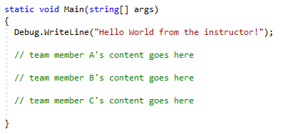
GitHub collaboration practice
Starter project
https://github.com/ISM6225/ForkStart_Group.git
Task
All students should see content from all three team members
Recommendations
Sync before Push
Before you push code to the shared repository, make sure you sync your local repository with the remote repository
This ensures that code is not lost
GitHub will reject a push if you started from a previous branch

Slide 57
Code walk-through
Search
https://github.com/ISM6225/Binary_Search.git
Fork to open the solution in your IDE
Sort
https://github.com/ISM6225/Sort.git
Fork to open the solution in your IDE
Data structures
https://github.com/ISM6225/L2_Algorithms_DataStructures
Fork to open the solution in your IDE

Slide 58
Code walk-through
Obtain video and example code for search from Github
Note: If you encounter the error about .NET core target
Download the latest .NET core SDK: https://dotnet.microsoft.com/download
Or, hack it: create a new console application project and replace the contents of Program.cs with the code on Github
Double-click the .sln file to open the project in Visual Studio
This is an important step
The solution file tells Visual Studio what type of project this is
Visual Studio can then interpret the files appropriately

Slide 59
Exercise - Search
How do print statements influence time measurements?
Run a few variants
Multiple statements with short strings
One statement with a long string
Multiple statements with long strings
What might be going on?
How did algorithmic considerations influence this I/ O design?

Slide 60
In-class activity
Time complexity quiz
4 questions
Multiple languages
Time 45 minutes
Logistics
Work individually
Feel free to assemble as your group
Feel free to discuss, search online etc
But focus on your own learning
Turn in work upon completion
Will be returned next weeks

Slide 61
Compare linear and binary search
Uncomment line 138 in Program.cs
Walk-through of code in Utilities.cs
Run the program to see the difference between linear search and binary search

Slide 62
Exercise - Sort
Fork the sort project from GitHub
Sort in different order
Ascending order instead of descending order
Sort array of characters

Slide 63
References
https://ocw.mit.edu/courses/electrical-engineering-and-computer-science/6-006-introduction-to-algorithms-fall-2011/lecture-videos/MIT6_006F11_lec02_orig.pdf
Cormen, Thomas H. and Leiserson, Charles E. and Rivest, Ronald L. and Stein, Clifford, Introduction to Algorithms, ISBN 0262033844, MIT Press, 3rd Ed, 2009
http://algorithmics.lsi.upc.edu/docs/Dasgupta-Papadimitriou-Vazirani.pdf
https://en.wikipedia.org/wiki/Muhammad_ibn_Musa_al-Khwarizmi

